Slide 1
CloudFront
Content Delivery Network

Slide 5
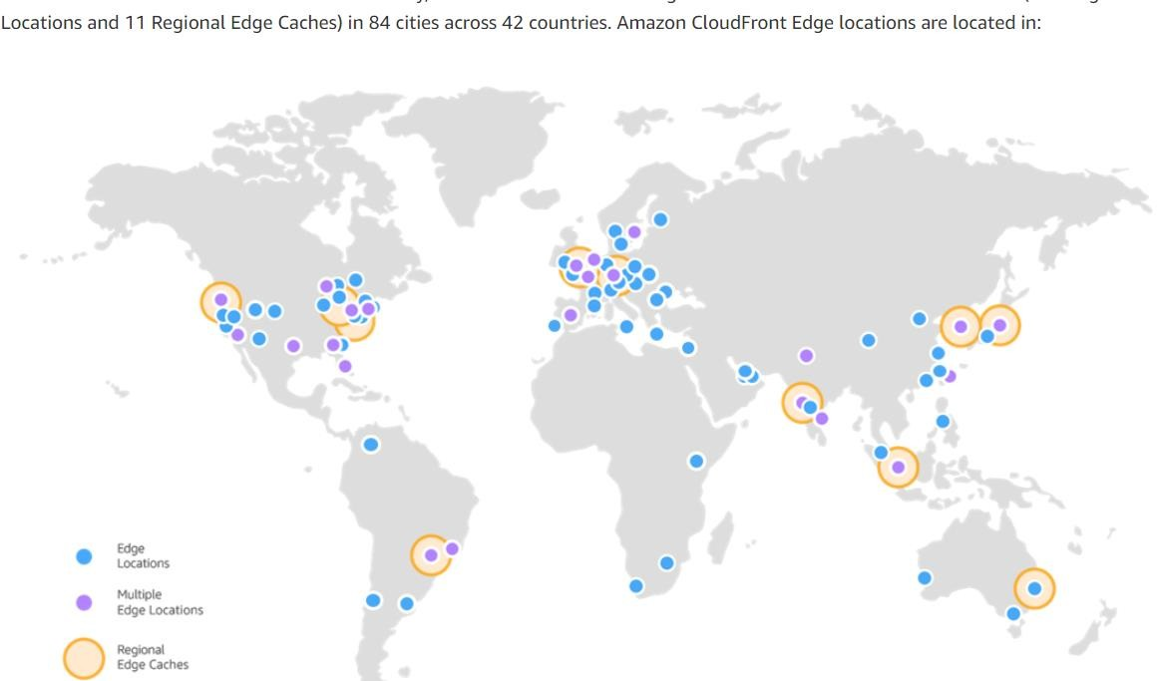
Source: https://aws.amazon.com/cloudfront/features/
Copyright © 2019 ChandraMohan Lingam. All Rights Reserved.

Slide 6
Types of Content
Static – videos, images, JavaScript
Dynamic – weather data
User specific – user photo, health report
Not-Cacheable – OTP (one-time password), payment card details
HTTP Cache Control Headers – cache or not to cache, how long to cache, public or private cache and so forth

Slide 7
CloudFront Performance
Cache copies of content close to your users
CloudFront routes request to nearest edge location
For content not available at edge and regional edge cache:
Request is sent to the origin
CloudFront keeps persistent connection to Origin – minimizes connection establishment overhead
Data transfer over AWS backbone network (for origin hosted in AWS)

Slide 8
Origin
Dynamic and Static Content
Streaming, Video on demand, Live streaming
CloudFront
Restrict access - Signed URLs, Signed Cookies
Geo Restriction
Configurable Caching, Invalidation Option
S3
ELB
EC2
Custom
Origin
Personalized – Query String Parameters, HTTP Cookies
Backup Origin (primary not healthy)

Slide 9
Security, Lambda@Edge

Slide 10



Securing S3 Origin
Origin Access Identity – Limit access to S3 bucket only from CloudFront Identity
When configured, CloudFront uses OAI credentials to sign S3 requests
CloudFront
OAI
S3

Slide 11




Securing App Origin
Static Custom Header – To validate requests from CloudFront
Static Custom Header
CloudFront
App
Lambda@Edge
Custom Header
Sign Requests
Sign Requests, Custom Header
SSL/TLS
Field Level Encryption (example: credit card number)
CloudFront
Lambda@Edge
Customize – HTTP Cookies, Query String Parameters

Slide 12
Security at the Edge
CloudFront – Front door for your application. Shield your critical content and infrastructure
CloudFront
AWS Shield
AWS Shield
Protection against DDoS Attacks. Standard features (no cost) – protects against layer 3 and layer 4 attacks
Advanced (paid) – protection against larger and more sophisticated attacks (ELB, CloudFront, Route53), billing protection
Web Application Firewall
WAF
Control access to content (allow, deny, count requests based on criteria)
SQL Injection, Cross-site scripting Protection

Slide 13
Lambda functions at edge locations
Lambda@Edge
Customize application behavior – without touching
origin systems
Run application logic close to your end users Improve responsiveness
Configure to run in-response to request lifecycle:
Viewer Request/Response
Origin Request/Response
Verify Authentication Credentials at Edge - JWT (JSON Web Tokens)
Bot detection

